Slide 1
Group Name: Pelican
Topic: Corona Virus

Slide 2
Outline
Introduction
Origin
Effects & Symptoms
Cure & Prevention
Conclusion

Slide 3
Introduction
Corona Virus have made an alarming situation now a days.
The name “Corona Virus” is derived from the Latin Corona meaning ‘çrown’ or ‘halo’.
It causes illness ranging from the common cold.

Slide 4
A nCov is a new strain that has not been previously identified.
The genome size of Corona viruses ranges from approximately 26 to 32 kilobases.

Slide 5
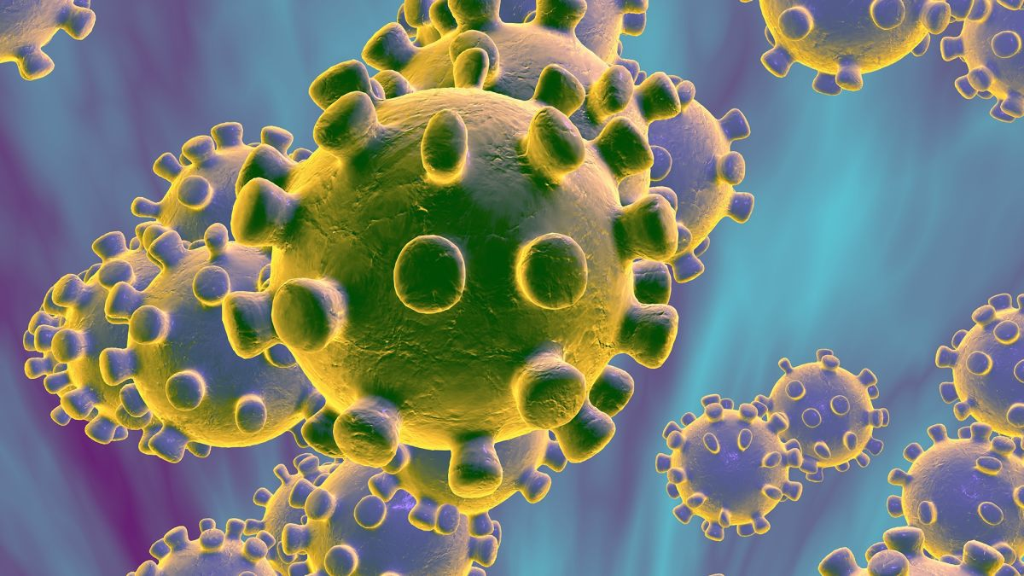

Slide 6
Origin:
Coronavirus first outbreak at Wuhan, China.
It comes from a Wuhan seafood market.
First case was reported on December 31st,2019.
Initial source is still unknown.
China has reached 1,868 death with 72,436 infected people.

Slide 7
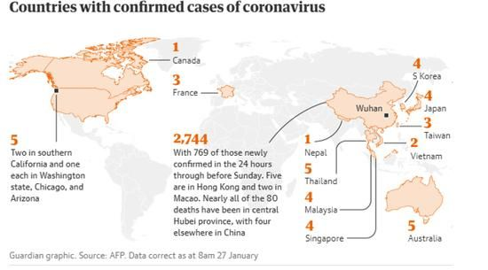
Affected areas

Slide 8
Effects and Symptoms:
The symptoms of most Coronaviruses are similar to any upper respiratory infection.
It’s infection can cause pneumonia and other fatal deseases.
It weakens our immune systems.

Slide 9
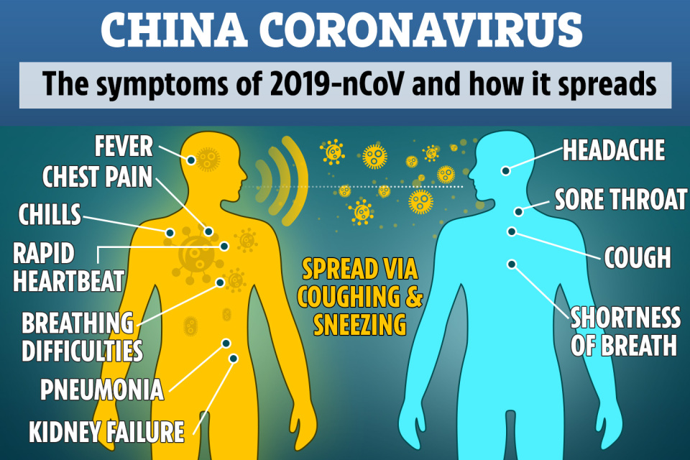

Slide 10
Treatment & Prevention:
Drug combination of (lopinavir & ritonavir) , remdesivir are used to treat the infected patient.
We need to take some steps to protect ourselves from it like
Wash our hands with soup for 20 seconds.
Avoid dead or alive animal ,sick people etc.

Slide 11
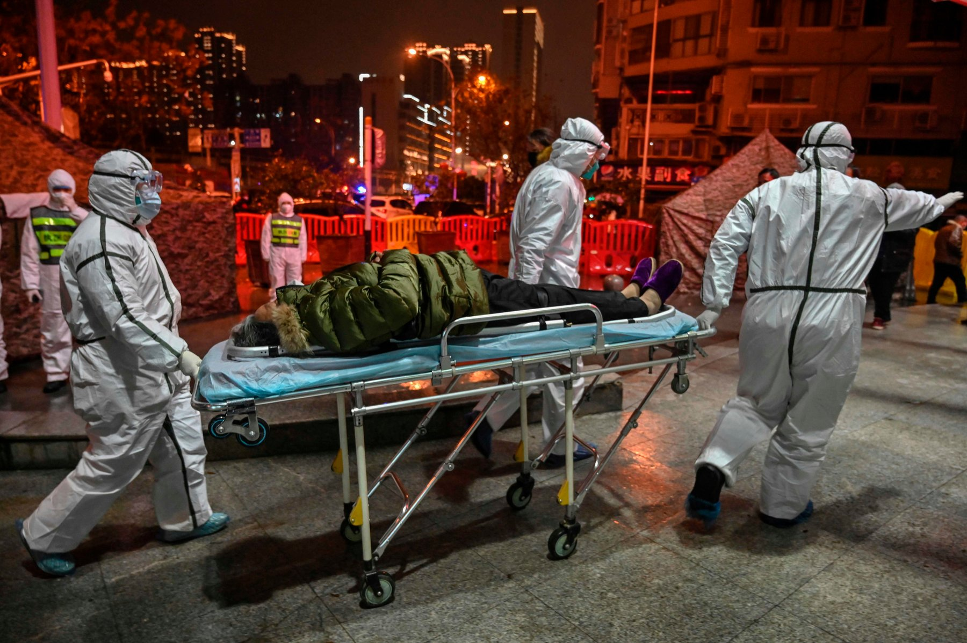

Slide 12
Conclusion:
Coronavirus infection occurs primarily winter sometimes fall and spring
There is currently no treatment recommended for Coronavirus infection.
Coronavirus subsequently spread throughout China and elsewhere.
People need to know about the affect and protection from Coronavirus.

Slide 13
Thank you everyone.

